Slide 1

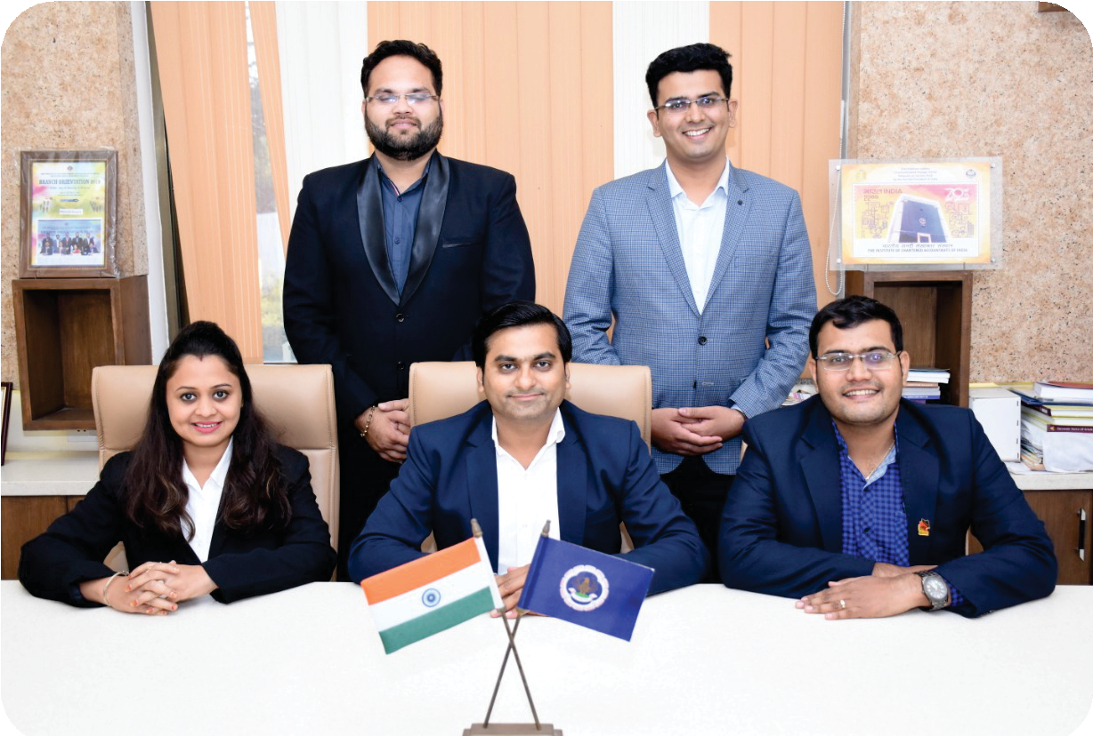
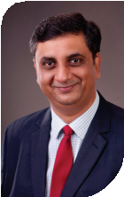
ACTIVITY REPORT-2019
BHARUCH BRANCH OF WIRC OF ICAI BHARUCH
CHAIRMAN
CA MAHAVIR JAIN
VICE CHAIRMAN
CA HARSHIT SHAH
SECRETARY
CA RUSHI GANDHI
TREASURER
CA AKSHAR MEHTA
MEMBER
CA PINAL MODI
BRANCH NOMINEE
CA VISHAL DOSHI (RCM)

Slide 2
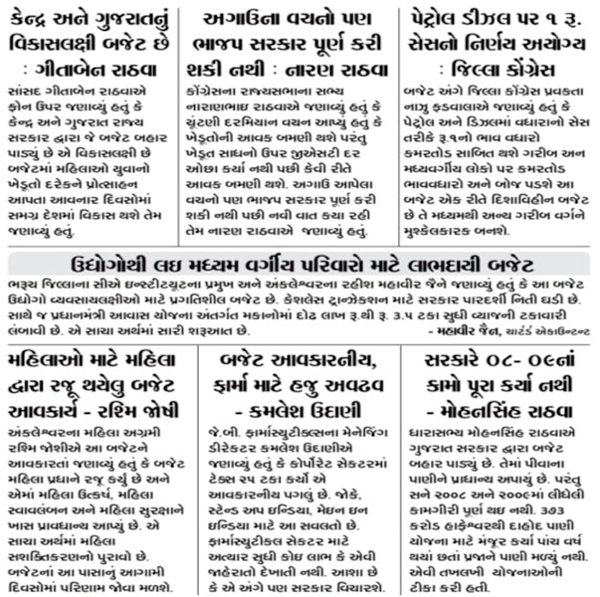
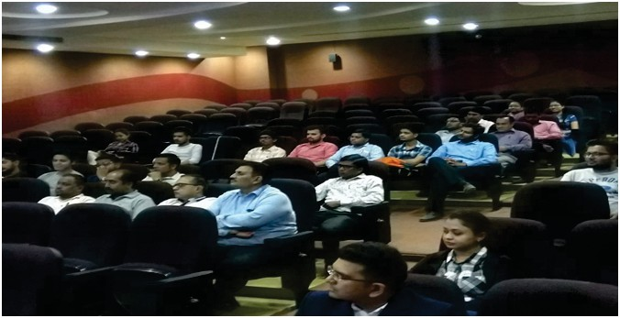
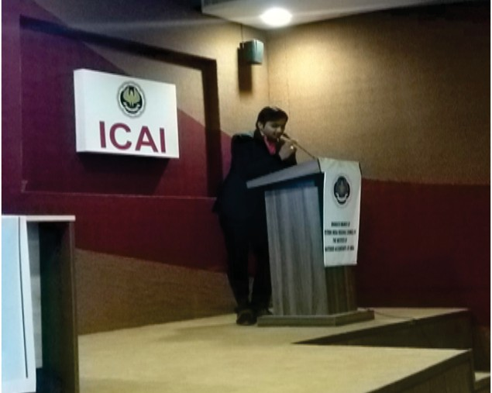
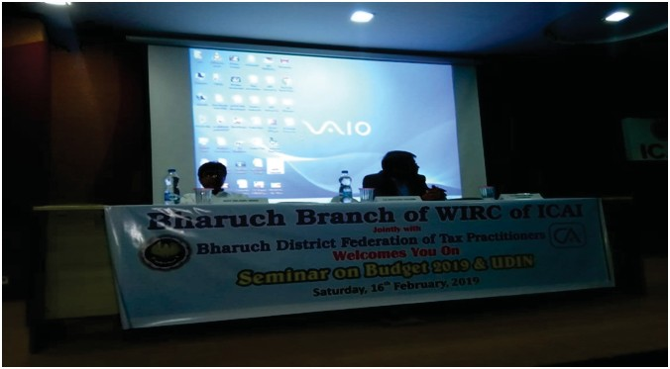
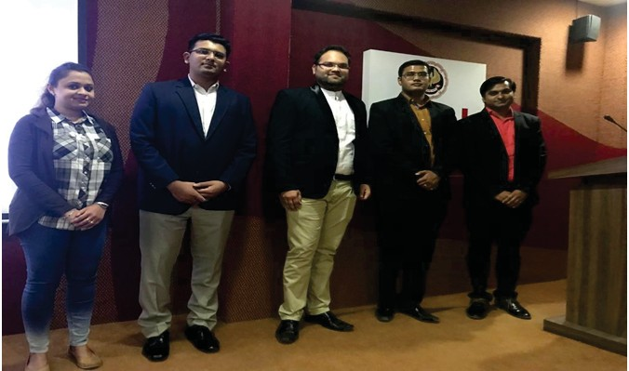
BHARUCH BRANCH OF WIRC OF ICAI BHARUCH
ACTIVITY REPORT-2019
PROGRAMS ORGANIZED FOR MEMBERS IN INDUSTRY
1.SEMINAR ON BUDGET-2019 : CA ABHISHEK NAGORI DATE : 16TH FEBRUARY
CPE : 3 HOURS
NO. OF PARTICIPANTS : 26

Slide 3
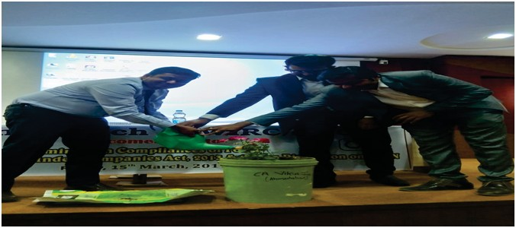
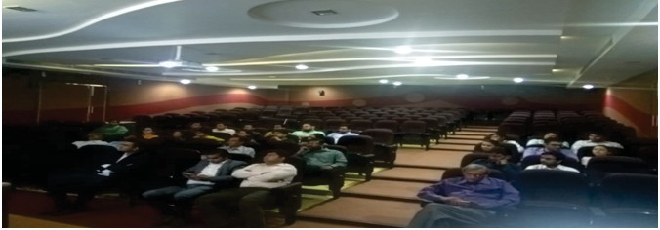
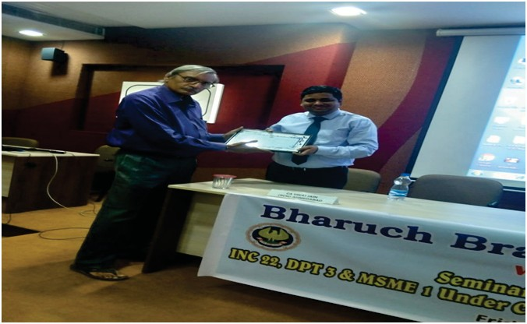
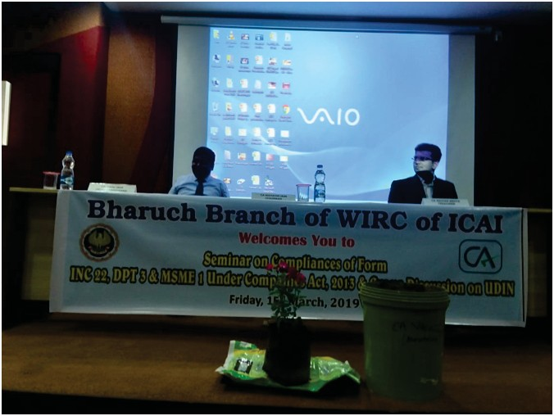
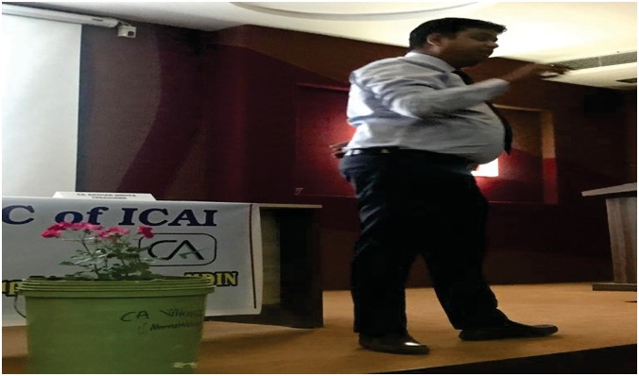
BHARUCH BRANCH OF WIRC OF ICAI BHARUCH
ACTIVITY REPORT-2019
LECTURE MEETINGS
2. SEMINAR ON FORM INC22 , DPT3, MSME : CA VIKAS JAIN
DATE : 14TH MARCH 2019
CPE : 3 HOURS
NO. OF PARTICIPANTS : 31

Slide 4
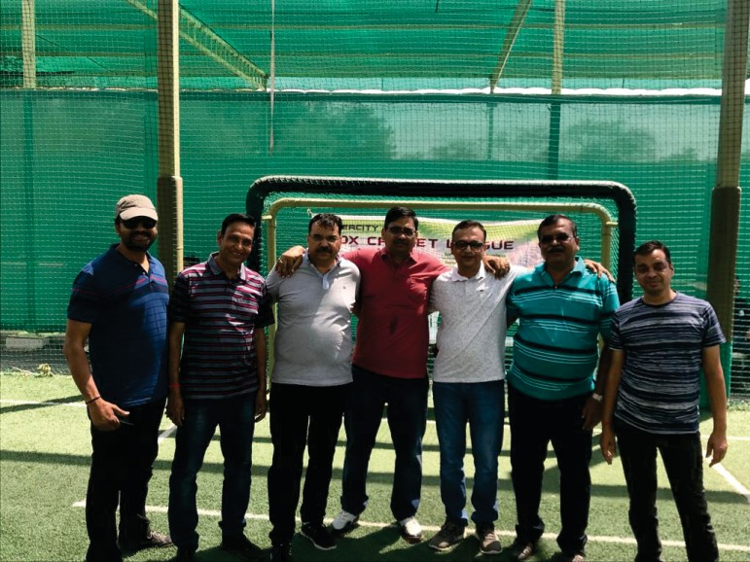
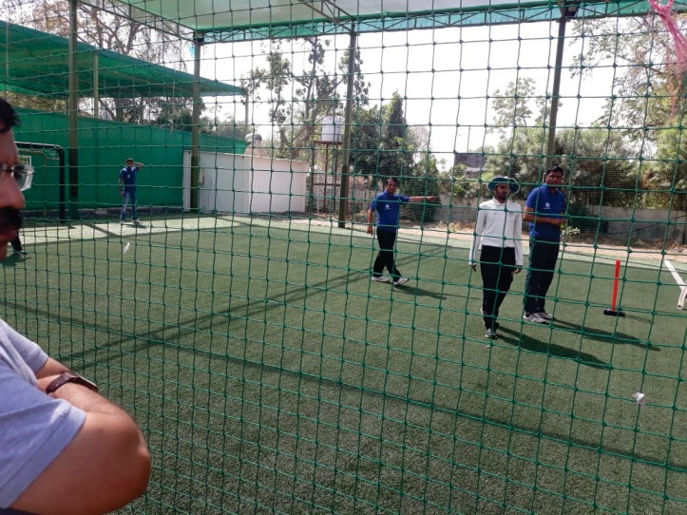
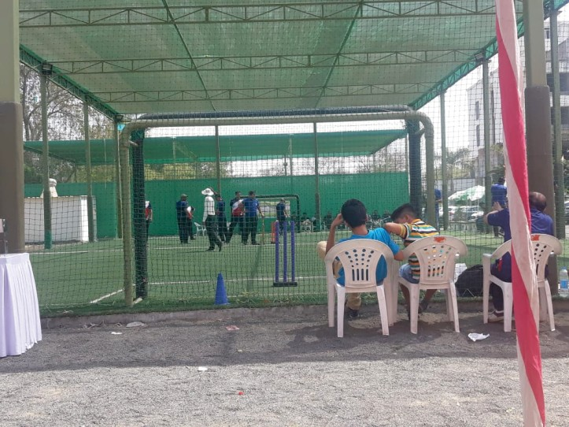
BHARUCH BRANCH OF WIRC OF ICAI BHARUCH
ACTIVITY REPORT-2019
JOINT PROGRAMS WITH
3. Intercity Box Cricket League 40+ aged CA Jointly with Ahmedabad & Baroda Branch DATE : 16-03-2019
NEAR BY BRANCHES

Slide 5
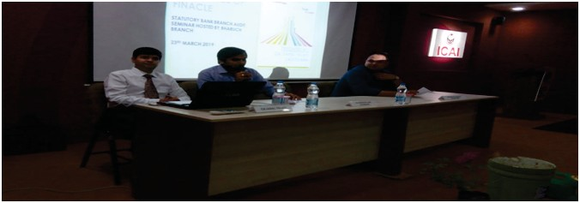
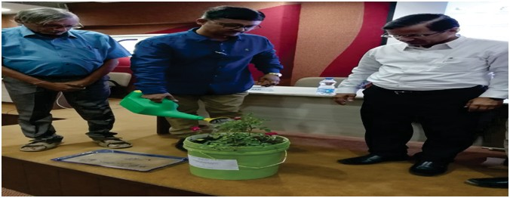
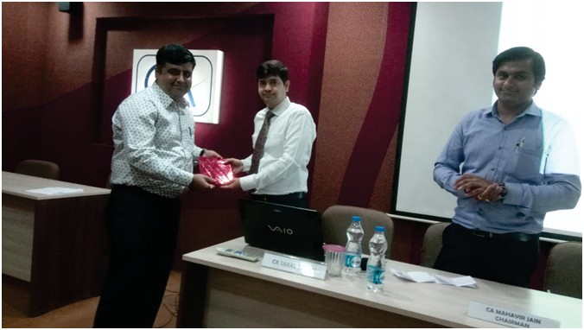
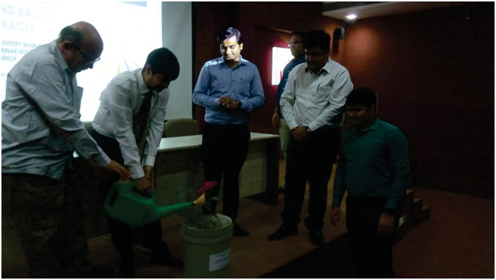
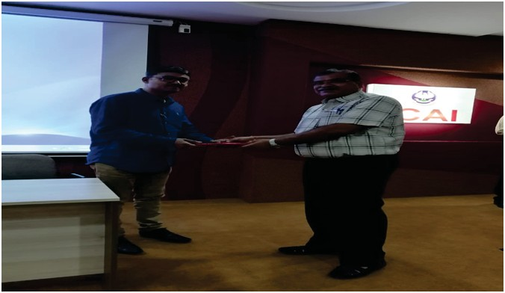
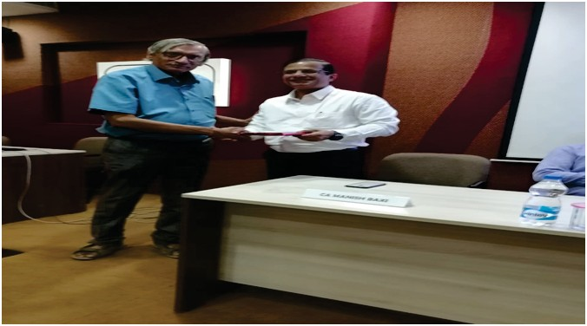
BHARUCH BRANCH OF WIRC OF ICAI BHARUCH
ACTIVITY REPORT-2019
4.SEMINAR ON BANK AUDIT : CA MANISH BAXI , CA PIYUSH SHAH, CA SARAL TALATI
DATE : 23RD MARCH 2019
CPE : 6 HOURS
NO. OF PARTICIPANTS : 29

Slide 6
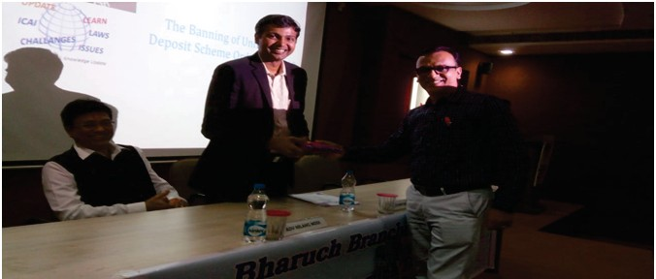
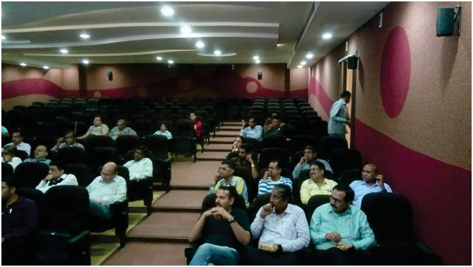
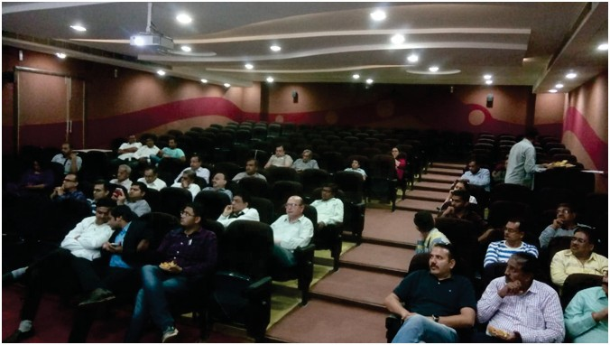
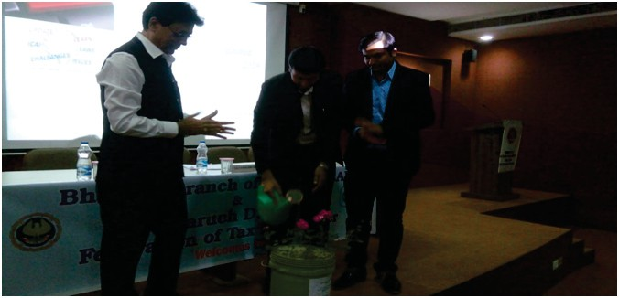
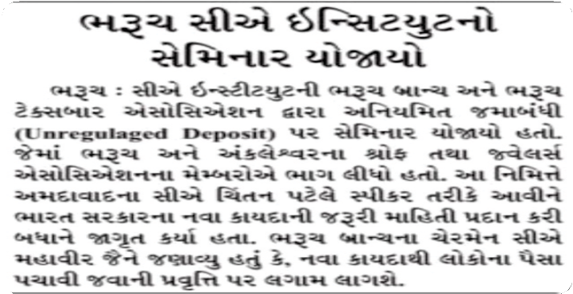
BHARUCH BRANCH OF WIRC OF ICAI BHARUCH
ACTIVITY REPORT-2019
LECTURE MEETINGS
5.SEMINAR ON THE BANKING OF UNREGULATED DEPOSIT SCHEME ORDINANACE -2019 : CA CHINTAN PATEL DATE : 30TH MARCH 2019
CPE : 3 HOURS
NO. OF PARTICIPANTS : 24

Slide 7
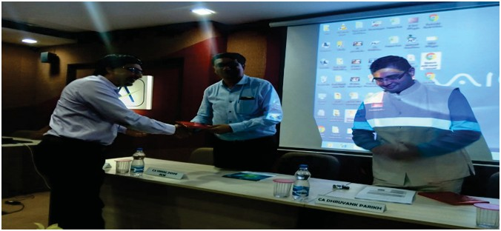
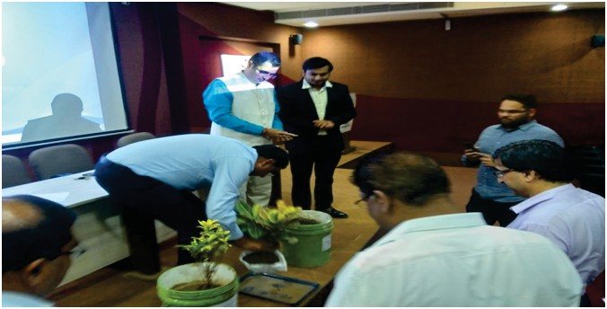
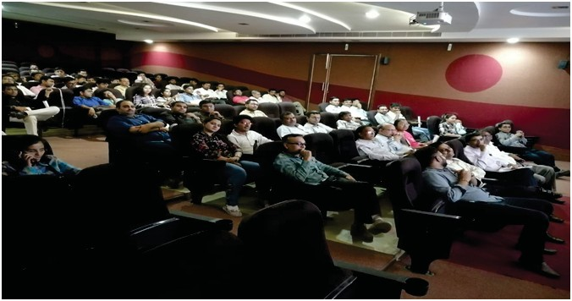
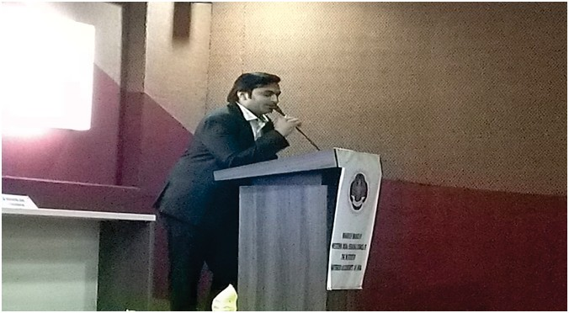
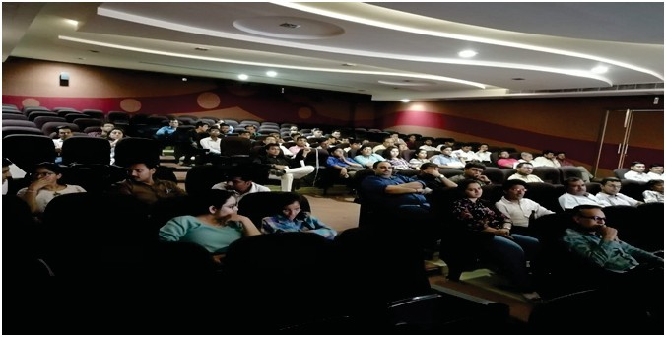
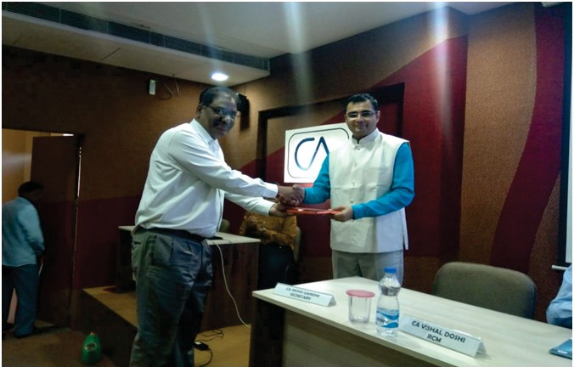
BHARUCH BRANCH OF WIRC OF ICAI BHARUCH
ACTIVITY REPORT-2019
PROGRAMS ORGANIZED FOR MEMBERS IN INDUSTRY
6. SEMINAR ON GST ANNUL RETURN 9C : CA DHRUVANK PARIKH
DATE : 2ND MAY 2019
CPE : 6 HOURS
NO. OF PARTICIPANTS : 82

Slide 8
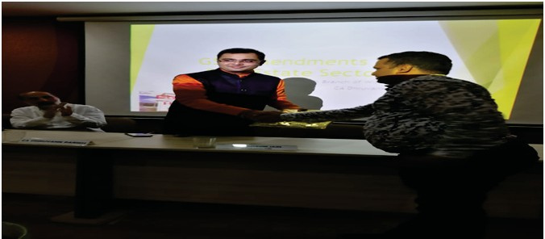
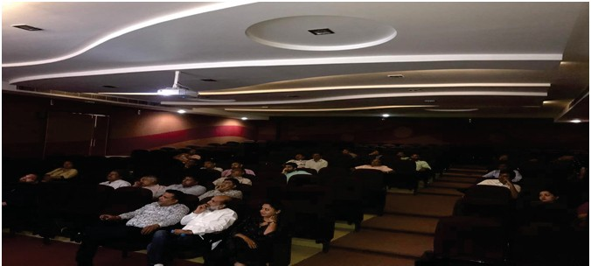
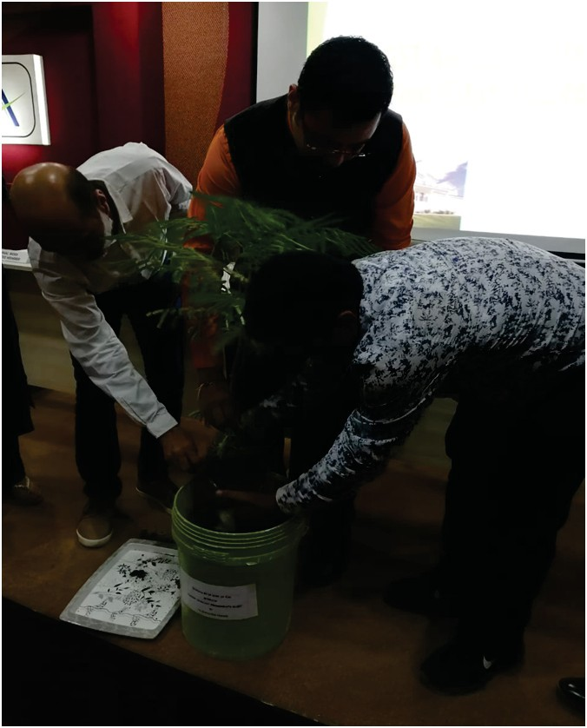
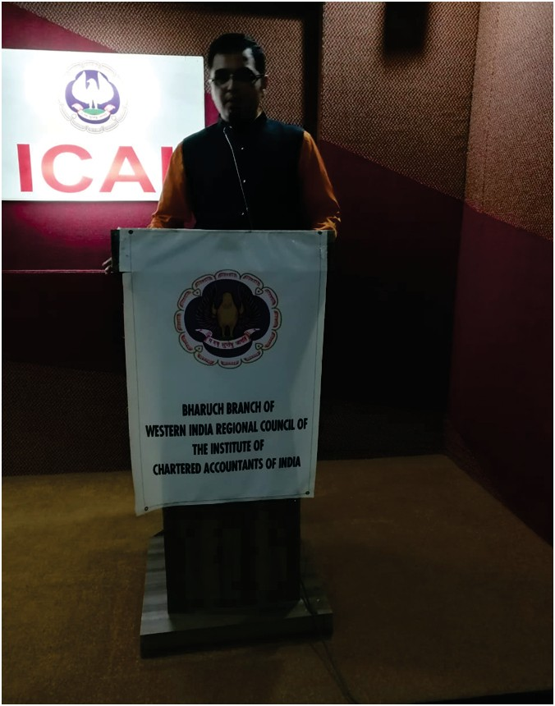
BHARUCH BRANCH OF WIRC OF ICAI BHARUCH
ACTIVITY REPORT-2019
LECTURE MEETINGS
7. RECENT AMENDMENTS IN GST OF REAL ESTATE & RERA : CA DHRUVANK PARIKH
DATE : 17TH MAY 2019
CPE : 3 HOURS
NO. OF PARTICIPANTS :19

Slide 9
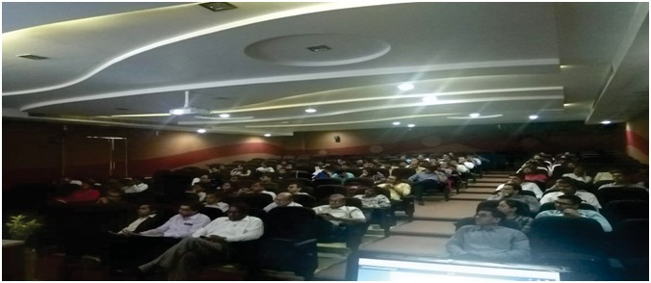
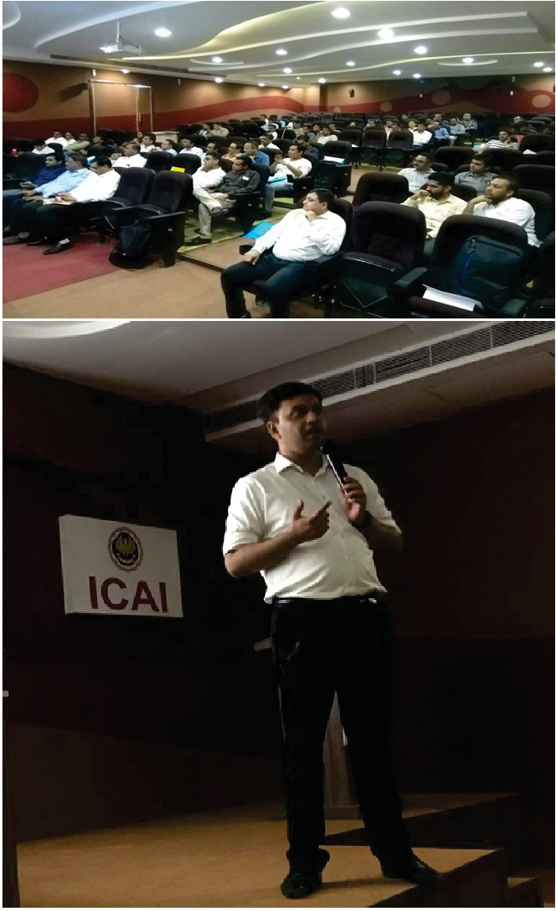
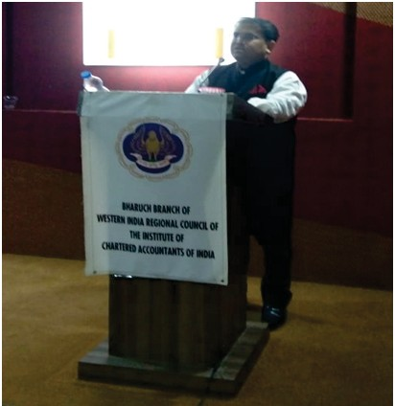
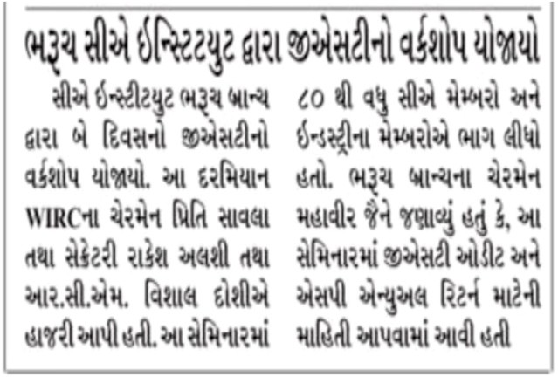
BHARUCH BRANCH OF WIRC OF ICAI BHARUCH
ACTIVITY REPORT-2019
PROGRAMS ORGANIZED FOR MEMBERS IN INDUSTRY
8. 2DAYS WORKSHOP ON GST : DATE : 14TH AND 15TH JUNE 2019 CPE : 12 HOURS
NO.OF PARTICIPANTS : 22

Slide 10
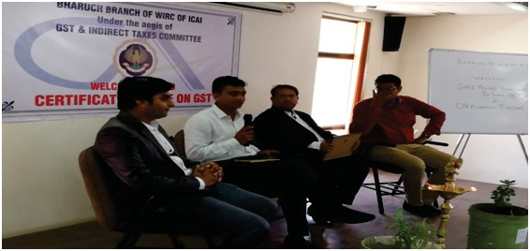
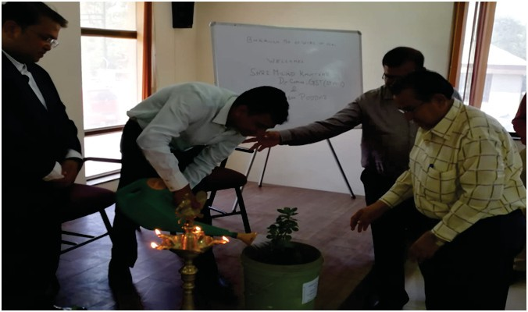
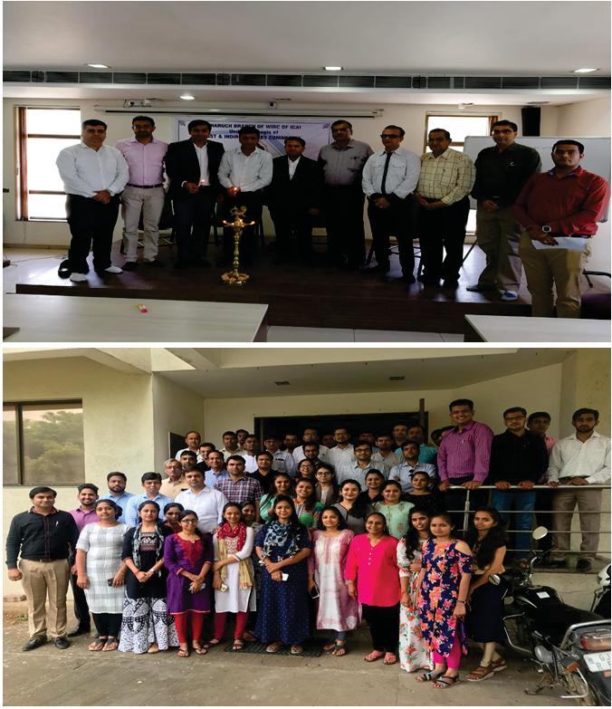
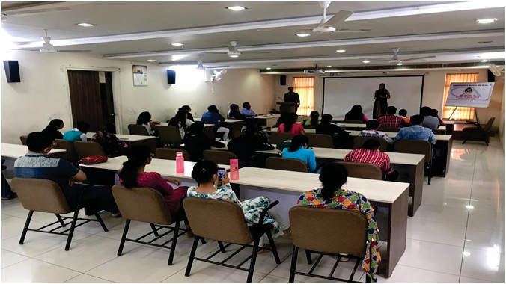
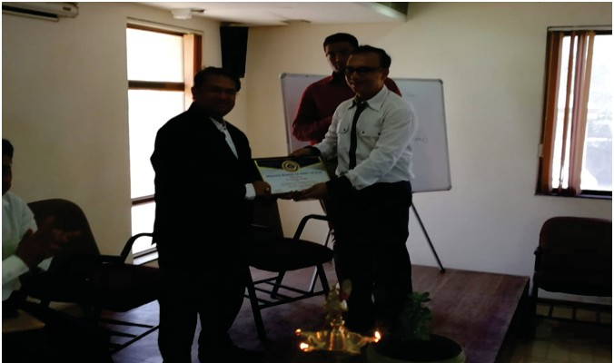
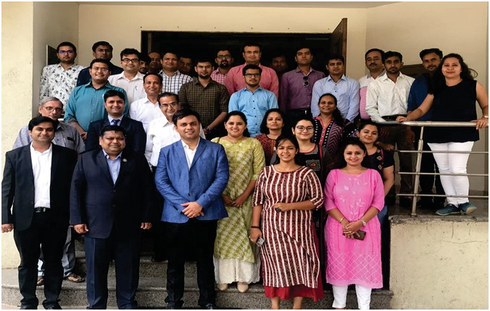
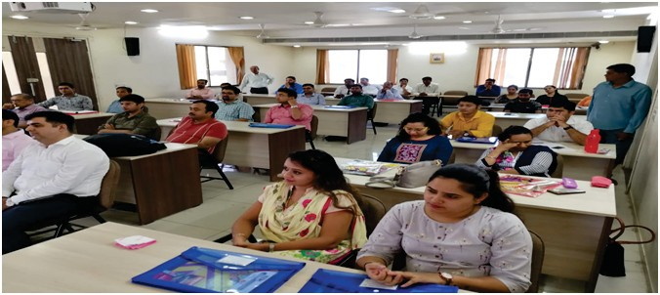
BHARUCH BRANCH OF WIRC OF ICAI BHARUCH
ACTIVITY REPORT-2019
9. CERTIFICATE COURSE ON GST :
DATE : 1ST JUNE 2019 TO 30TH JUNE 2019 CPE : 30 HOURS
NO. OF PARTICIPANTS : 29
CERTIFICATE COURSES

Slide 11
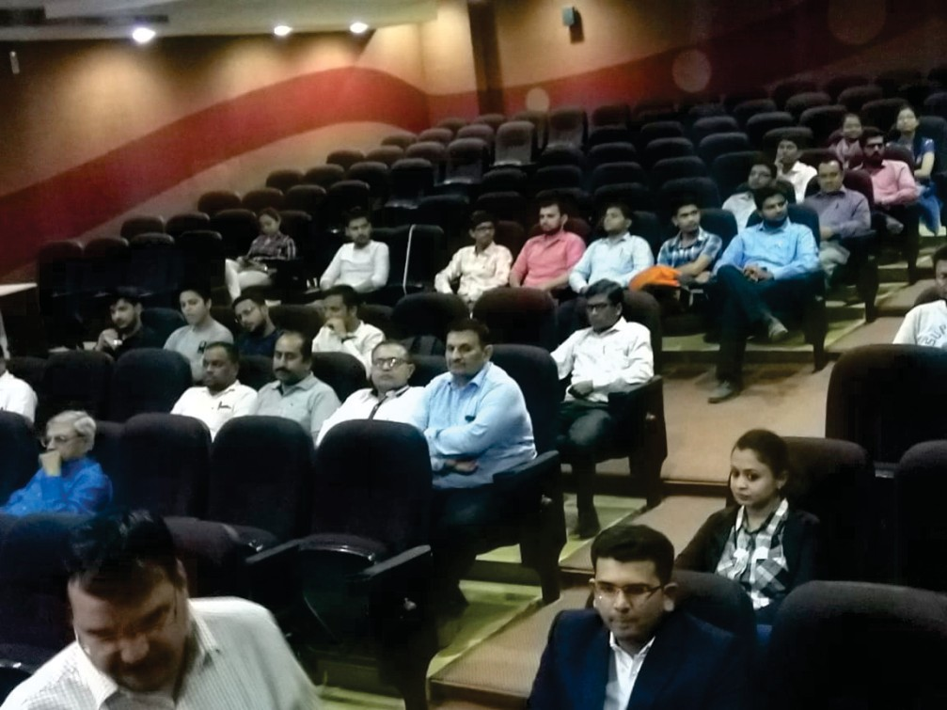
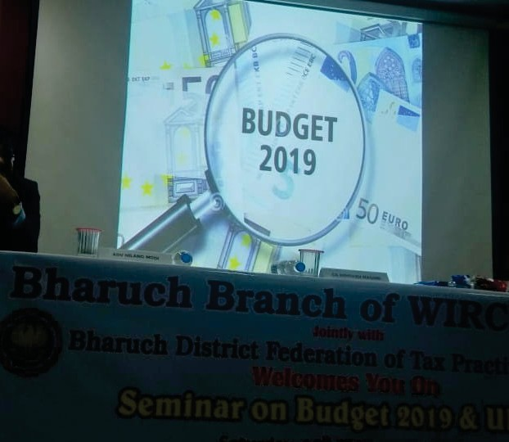
BHARUCH BRANCH OF WIRC OF ICAI BHARUCH
ACTIVITY REPORT-2019
PROGRAMS ORGANIZED FOR MEMBERS IN INDUSTRY & LECTURE MEETING
10. ANALYSIS OF UNION BUDGET -2019 DATE : 8TH JULY 2019
CPE : 3 HOURS
NO. OF PARTICIPANTS :16

Slide 12
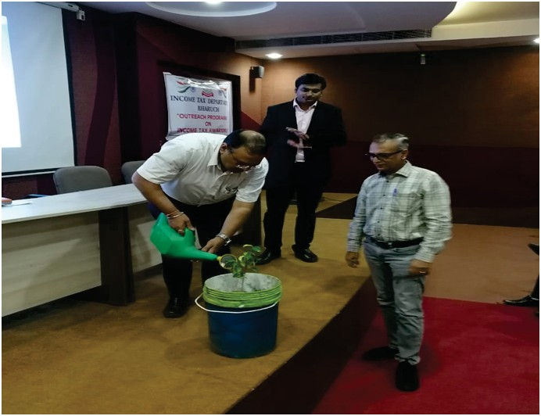




BHARUCH BRANCH OF WIRC OF ICAI BHARUCH
ACTIVITY REPORT-2019
LECTURE MEETINGS & PROGRAM WITH GOVT. DEPARTMENT
11. AMENDMENTS IN INCOME TAX RETURN JOINTLY WITH IT DEPT. BHARUCH ALONGWITH 20 OFFICIALS FROM THE DEPT. : CA RAHULDEO PATEL DATE : 22ND JULY 2019
CPE : 3 HOURS
NO.OF PARTICIPANTS :44

Slide 13



BHARUCH BRANCH OF WIRC OF ICAI BHARUCH
ACTIVITY REPORT-2019
JOINT PROGRAMS WITH
12. TAX AUDIT JOINTLY WITH BARODA BRANCH : DATE : 17 TH AUGUST 2019
CPE : 6 HOURS
NEAR BY BRANCHES

Slide 14




BHARUCH BRANCH OF WIRC OF ICAI BHARUCH
ACTIVITY REPORT-2019
13. SEMINAR ON TAX AUDIT REPORT & SAB KA VISHWAS : CA HARDIK DHARIWAL
( LEGACY DISPUTE RESOLUTION SCHEME, 2019) : CA S M PAREEK
DATE :14TH SEPTEMBER 2019 CPE : 3 HOURS
NO . O PARTICIPANTS : 22
LECTURE MEETINGS

Slide 15





BHARUCH BRANCH OF WIRC OF ICAI BHARUCH
ACTIVITY REPORT-2019
14.ANALYSIS OF VAT AMINSTY SCHEME-2019 WITH GST DEPT ALONGWITH 10 OFFICIALS FROM THE DEPT. SHRI C B PATEL (JT. COM )
: SHRI MILIND KAVATKAR (DY COM , SGST)
DATE :10TH OCTOBER 2019 CPE : 3 HOURS
NO.OF PARTICIPANTS : 14
LECTURE MEETINGS & PROGRAM WITH GOVT. DEPARTMENT

Slide 16





BHARUCH BRANCH OF WIRC OF ICAI BHARUCH
ACTIVITY REPORT-2019
15.E – ASSESSMENT INCLUDING REASSESSMENT & IMP CBDT CIRCULARS :
CA JIGNESH PARIKH
DATE : 9TH NOVEMBER 2019 CPE : 3 HOURS
NO.OF PARTICIPANTS : 13
LECTURE MEETINGS

Slide 17






BHARUCH BRANCH OF WIRC OF ICAI BHARUCH
ACTIVITY REPORT-2019
16. RRC AT STATUE OF UNITY JTLY. WITH BARODA BR WIRC OF ICAI :
CA ABHAY DESAI , CA AVINASH PODDAR ,
CA GAURAV GUPTA , CA JATIN HARJAI CA DHINAL SHAH , CA JAY CHHAIRA , CA ANKIT TALATI , CA VIKAS SHAH
DATE :23RD NOVEMBER AND 24TH NOVEMBER 2019
CPE : 9 HOURS NO. OF PARTICIPANTS : 41
JOINT PROGRAMS WITH
NEAR BY BRANCHES

Slide 18






BHARUCH BRANCH OF WIRC OF ICAI BHARUCH
ACTIVITY REPORT-2019
16. RRC AT STATUE OF UNITY JTLY. WITH BARODA BR WIRC OF ICAI :
CA ABHAY DESAI , CA AVINASH PODDAR ,
CA GAURAV GUPTA , CA JATIN HARJAI CA DHINAL SHAH , CA JAY CHHAIRA , CA ANKIT TALATI , CA VIKAS SHAH
DATE :23RD NOVEMBER AND 24TH NOVEMBER 2019
CPE : 9 HOURS NO. OF PARTICIPANTS : 41

Slide 19



BHARUCH BRANCH OF WIRC OF ICAI BHARUCH
ACTIVITY REPORT-2019
LECTURE MEETINGS
17. SEMINAR ON ADVANCE MICROSOFT EXCEL : CA SHIVAM SONI
DATE : 11TH DECEMBER 2019 :
CPE : 3 HOURS
NO.OF PARTICIPANTS : 35

Slide 20




BHARUCH BRANCH OF WIRC OF ICAI BHARUCH
ACTIVITY REPORT-2019
LECTURE MEETINGS
18. SEMINAR ON GST NEW RETURNS , SABKA VISHWAS SCHEME , COMPLICATION IN 9A & 9C RETURNS :CA DHRUVANK PARIKH DATE : 21ST DECEMBER 2019
CPE : 3 HOURS
NO.OF PARTICIPANTS :47

Slide 21





BHARUCH BRANCH OF WIRC OF ICAI BHARUCH
ACTIVITY REPORT-2019
19. REGIONAL CONFERENCE ON CORPORATE & ALLIED LAWS ORGANIZED BY CORPORATE & ALLIED LAWS & CORPORATE GOVERNANCE COMMITTEE OF WIRC OF ICAI : CA VISHAL DOSHI , CA SAMIR PARIKH CA SURIL MEHTA , CA SARTHAK BHANUSHALI ,
CA AJIT KUMAR SHAH DATE : 28TH DECEMBER 219 CPE : 6 HOURS
NO.OF PARTICIPANTS : 30
REGIONAL CONFERENCE

Slide 22


BHARUCH BRANCH OF WIRC OF ICAI BHARUCH
ACTIVITY REPORT-2019
20. MEETING WITH GST DEPARTMENT TO SOLVE QUERRIES RELATED TO MEMBER AND ALSO REPRESENTATION TO GST COUNCIL :
DATE : 22ND MAY 2019 NO. OF PARTICIPANTS : 26
PROGRAM WITH GOVT. DEPARTMENT

Slide 23






BHARUCH BRANCH OF WIRC OF ICAI BHARUCH
ACTIVITY REPORT-2019
70TH CA DAY –PLATINUM JUBLEE –CELEBRATION:
  FLAG HOISTING
  CLEAN INDIA ABHIYAN
  BLOOD DONATION CAMP
  Felicitation of Newly Passed CAs DATE : 1ST JULY 2019
OTHER ACTIVITIES :

Slide 24





BHARUCH BRANCH OF WIRC OF ICAI BHARUCH
ACTIVITY REPORT-2019
70TH CA DAY –PLATINUM JUBLEE –CELEBRATION:
  FLAG HOISTING
  CLEAN INDIA ABHIYAN
  BLOOD DONATION CAMP DATE : 1ST JULY 2019
CONTRIBUTION TO SOCIETY

Slide 25




BHARUCH BRANCH OF WIRC OF ICAI BHARUCH
ACTIVITY REPORT-2019
22. (1) CELEBRATION OF 73RD INDEPENDENCE DAY / FLAG HOISTING
(2) ELICITATION OF NEWLY PASSED CAS DATE : 15TH AUGUST 2019

Slide 26


BHARUCH BRANCH OF WIRC OF ICAI BHARUCH
ACTIVITY REPORT-2019
23. MEETING WITH VAT DEPT. OR CLARIFICATION ON VARASAMADHAN YOJNA , 2019:
DATE : 19TH SEPTEMBER 2019 NO .OF PARTICIPANTS : 22
PROGRAM WITH GOVT. DEPARTMENT

Slide 27


BHARUCH BRANCH OF WIRC OF ICAI BHARUCH
ACTIVITY REPORT-2019
24. MEETING WITH CHIEF COMM. OF INCOME TAX AT BARODA TO REPRESENT VARIOUS ISSUES RELATING TO E-PROCEEDINGS:
DATE : 9TH DECEMBER 2019
PROGRAM WITH GOVT. DEPARTMENT

Slide 28


BHARUCH BRANCH OF WIRC OF ICAI BHARUCH
ACTIVITY REPORT-2019
STUDENTS RELATED
25. WORKSHOP ON PRACTICAL ASPECTS OF AUDIT : DATE : 13TH AND 14TH JULY 2019
NO.OF PARTICIPATNS : 23

Slide 29





BHARUCH BRANCH OF WIRC OF ICAI BHARUCH
ACTIVITY REPORT-2019
26.BRANCH LEVEL QUIZ CONTEST , 2019-20 : DATE : 28TH JULY 2019
QUIZ CONTEST & TALENT HUNT

Slide 30





BHARUCH BRANCH OF WIRC OF ICAI BHARUCH
ACTIVITY REPORT-2019
CAREER COUNSELING PROGRAMS
27. CAREER COUNSELLING PROGRAMME AT CHANDRABALA MODY ACADEMY :
DATE : 24TH APRIL 2019
NO. OF PARTICIPANTS : 300 STUDENTS (APPROX)

Slide 31




BHARUCH BRANCH OF WIRC OF ICAI BHARUCH
ACTIVITY REPORT-2019
CAREER COUNSELING PROGRAMS
28. CAREER COUNSELLING PROGRAMME AT AMITY SCHOOL :
DATE : 5TH JULY 2019
NO. OF PARTICIPANTS : 300 STUDENTS ( APPX)

Slide 32





BHARUCH BRANCH OF WIRC OF ICAI BHARUCH
ACTIVITY REPORT-2019
CAREER COUNSELING PROGRAMS
29. CAREER COUNSELLING PROGRAMME AT SWAMI VIVEKANAND SCHOOL , ANK :
DATE : 22ND APRIL 2019
NO. OF PARTICIPANTS : 500 STUDENTS ( APPX)

Slide 33

BHARUCH BRANCH OF WIRC OF ICAI BHARUCH
ACTIVITY REPORT-2019
30. ADVANCED INTEGRATED COURSE ON INORMATION TECHNOLOGY & SOFT SKILLS (AICITSS-02 BATCH) :
DATE : 24TH JUNE 2019 TO 11TH JULY 2019 NO. OF PARTICIPANTS : 23
ADVANCE ITT

Slide 34


BHARUCH BRANCH OF WIRC OF ICAI BHARUCH
ACTIVITY REPORT-2019
ICITSS
31. INTEGRATED COURSE ON INFORMATION TECHNOLOGY & SOFT SKILLS (ICITSS-03): DATE : 22ND JULY 219 TO 8TH AUGUST 2019 NO. OF PARTICIPANTS : 20

Slide 35


BHARUCH BRANCH OF WIRC OF ICAI BHARUCH
ACTIVITY REPORT-2019
CAREER COUNSELING PROGRAMS
32. CAREER COUNSELLING PROGRAMME AT NARMADA COLLEGE , BHARUCH:
DATE : 19TH DECEMBER 2019
NO. OF PARTICIPANTS : 300 STUDENTS ( APPX.)

Slide 36



BHARUCH BRANCH OF WIRC OF ICAI BHARUCH
ACTIVITY REPORT-2019
MCS
33. ADVANCED INTEGRATED COURSE ON MANAGEMENT & COMMUNICATION SKIILS (MCS ) :
DATE : 28TH DECEMBER 2019 TO 13TH JANUARY 2019 NO. OF PARTICIPANTS : 28

Slide 37



BHARUCH BRANCH OF WIRC OF ICAI BHARUCH
ACTIVITY REPORT-2019
CONTRIBUTION TO SOCIETY
34 •CANDLE MARCH FOR MARTYR JAWAN IN PULWAMA ATTACK ON 16/02/2019

Slide 38




BHARUCH BRANCH OF WIRC OF ICAI BHARUCH
ACTIVITY REPORT-2019
35 •. WIRC TEAM VISIT : Date : 14/06/2019

Slide 39


BHARUCH BRANCH OF WIRC OF ICAI BHARUCH
ACTIVITY REPORT-2019
CONTRIBUTION TO SOCIETY
36 • YOGA DAY ON 21/06/2019:

Slide 40




BHARUCH BRANCH OF WIRC OF ICAI BHARUCH
ACTIVITY REPORT-2019
37
VISIT TO VARIOUS INDUSTRIES TO CONNECT INDUSTRY MEMBERS WITH BRANCH :
We have visited Industries at Dahej, Bharuch, Ankleshwar and Panoli. Have visited prominent business house like Birla Copper, Grasim, Reliance, GNFC,ONGC, BASF, Pentronet LNG, Sun Pharma , Sanoﬁ India & Aventis Pharma, Jebson Foods and many more

Slide 41



BHARUCH BRANCH OF WIRC OF ICAI BHARUCH
ACTIVITY REPORT-2019
CONTRIBUTION TO SOCIETY & PUBLIC PROGRAMS
38 Income tax awareness Programme with IT Department.
at RMPS International School.

Slide 42




BHARUCH BRANCH OF WIRC OF ICAI BHARUCH
ACTIVITY REPORT-2019
INVESTOR AWARNESS &
39 Investor awareness Programme with IT Department.
For General Public.
PUBLIC PROGRAMS

Slide 43

BHARUCH BRANCH OF WIRC OF ICAI BHARUCH
ACTIVITY REPORT-2019
40 1ST TIME LAUNCHING OF WEBSITE OF BHARUCH BARNCH
www.bharuch-icai.org
BHARUCH BRANCH OF WIRC OF ICAI
89801 56226
Email : bharuh@icai.org

Slide 44

BHARUCH BRANCH OF WIRC OF ICAI BHARUCH
ACTIVITY REPORT-2019
41 1ST MEMEBR’S DIRECTORY OF BHARUCH BRANCH :

